Slide 1





The Bucharest Ministerial Communique
27 April 2012
Ligia Deca
Coordinator Bologna Follow-Up Group Secretariat

Slide 2
“The European Higher Education Area in 2012: Bologna Process Implementation Report”
The Bologna Process:
Changed profoundly and irreversibly the structure of European higher education;
Facilitated academic progression through the “Bologna” instruments (ECTS, Diploma Supplement, Qualifications Frameworks etc.);
Facilitated student mobility;
Was decisive in the set-up of a european framework for quality assurance (ESG, EQAR etc.).
Significant progress, but a lot to be done still.
http://www.ehea.info/Uploads/%281%29/Bologna%20Process%20Implementation%20Report.pdf

Slide 3
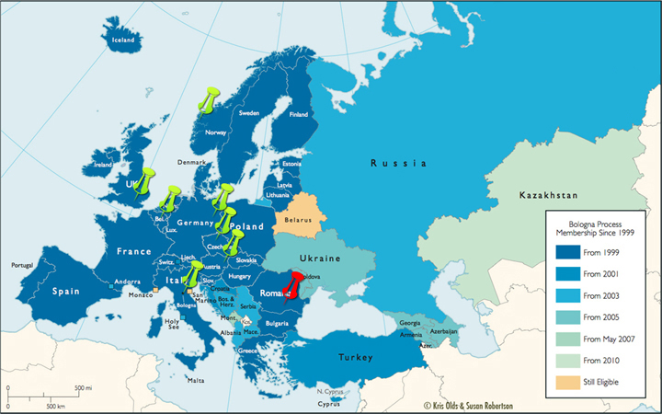
Ministerial Conferences
1999 - Bologna
2001 – Prague
2003 – Berlin
2005 – Bergen
2007 – London
2009 - Leuven/Louvain-la-Neuve
2010 - Budapest/Vienna
2012 – Bucharest

Slide 4
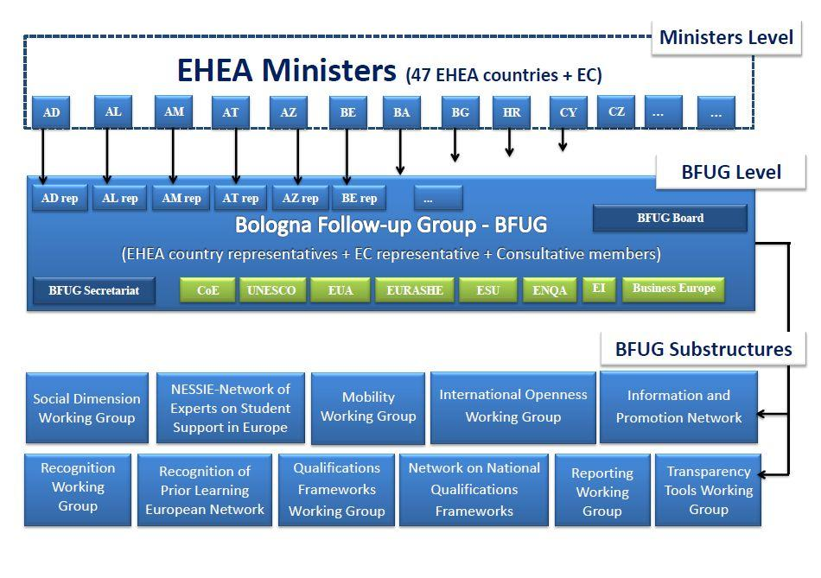

Slide 5
The Bucharest Ministerial Conference and Third Bologna Policy Forum
Main outcomes:
Bucharest Ministerial Conference Communique
EHEA ‘Mobility for better learning’ Strategy
Bologna Policy Forum Statement
Working group and stakeholder reports:
http://bologna-bucharest2012.ehea.info/background-documents.html

Slide 6
The Bucharest Communique
Main message: Higher education has a decisive contribution to overcoming the crisis and thus it should be regarded as an investment not an expenditure/ source of deficit.
Three main European political objectives:
provide quality higher education for all,
enhance graduates’ employability,
strengthen mobility as a means for better learning .

Slide 7
Quality higher education for all
Increasing the diversity of the student body, reducing inequalities and provision of student support;
Monitoring the national strategies in the field of social dimension (peer review);
Revising the ESG;
Promotion of a student centered approach to learning (SCL);
European dialogue on financing and governance of higher education.

Slide 8
Enhance graduates’ employability
Using learning outcomes as the fundamental glue to make the Bologna tools ensemble work (ECTS, DS, QF, QA ☺);
Revising the ECTS Users’ Guide;
Stronger link between research, teaching and learning at all levels
Using the same EQF reference levels: secondary school leaving certificate – 4; first cycle/ Bachelor – 6; second cycle/ Master – 7; third cycle/ PhD – 8;
Re-opening the discussion on the place and purpose of the short cycle( level 5?).

Slide 9
Strengthening mobility for better learning
Adoption of the EHEA “Mobility for Better Learning“ Strategy underpinning the ‘20% by 2020 mobile students’ target;
Encouraging the mitigation of the effects of unbalanced mobility;
Moving towards a European approach to quality ensure joint degrees;
European Area of Recognition (EAR) Manual;
Working towards automatic recognition of comparable degrees.

Slide 10
Support priorities
Developing a system of voluntary peer learning and reviewing in countries that request it;
Improving data collection;
Developing common EHEA transparency guidelines.

Slide 11
Follow-up
Priorities for action:
  At the European level;
  At the national level.
Adoption of the 2012-2015 BFUG workplan (during the BFUG meeting in August 2012 – Cyprus);

Slide 12
Resources
Bucharest Ministerial Conference website:
http://bologna-bucharest2012.ehea.info/
Permanent EHEA website: www.ehea.info
EHEA documents archive: http://archive.ehea.info/

Slide 13
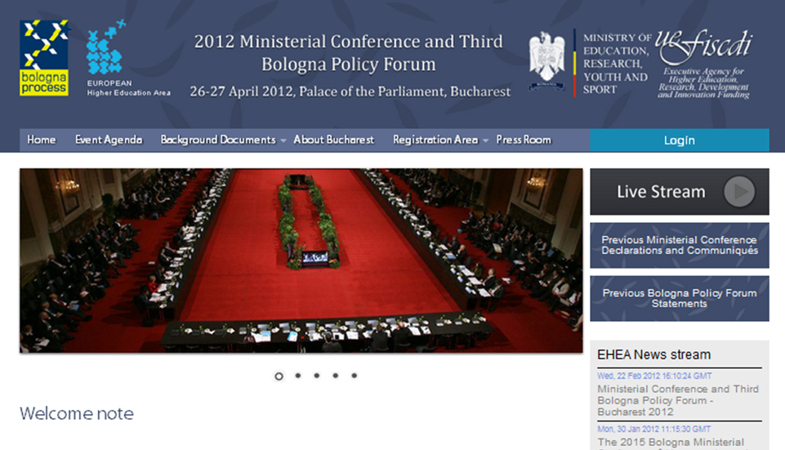
Thank you!
ligia.deca@ehea.info

