Slide 1

INTERNATIONAL CONFERENCE ON HIGHER EDUCATION REFORM
23-26 May 2012,
Petrovac, Montenegro
Jelica Minić
Deputy Secretary General of the RCC

Slide 2
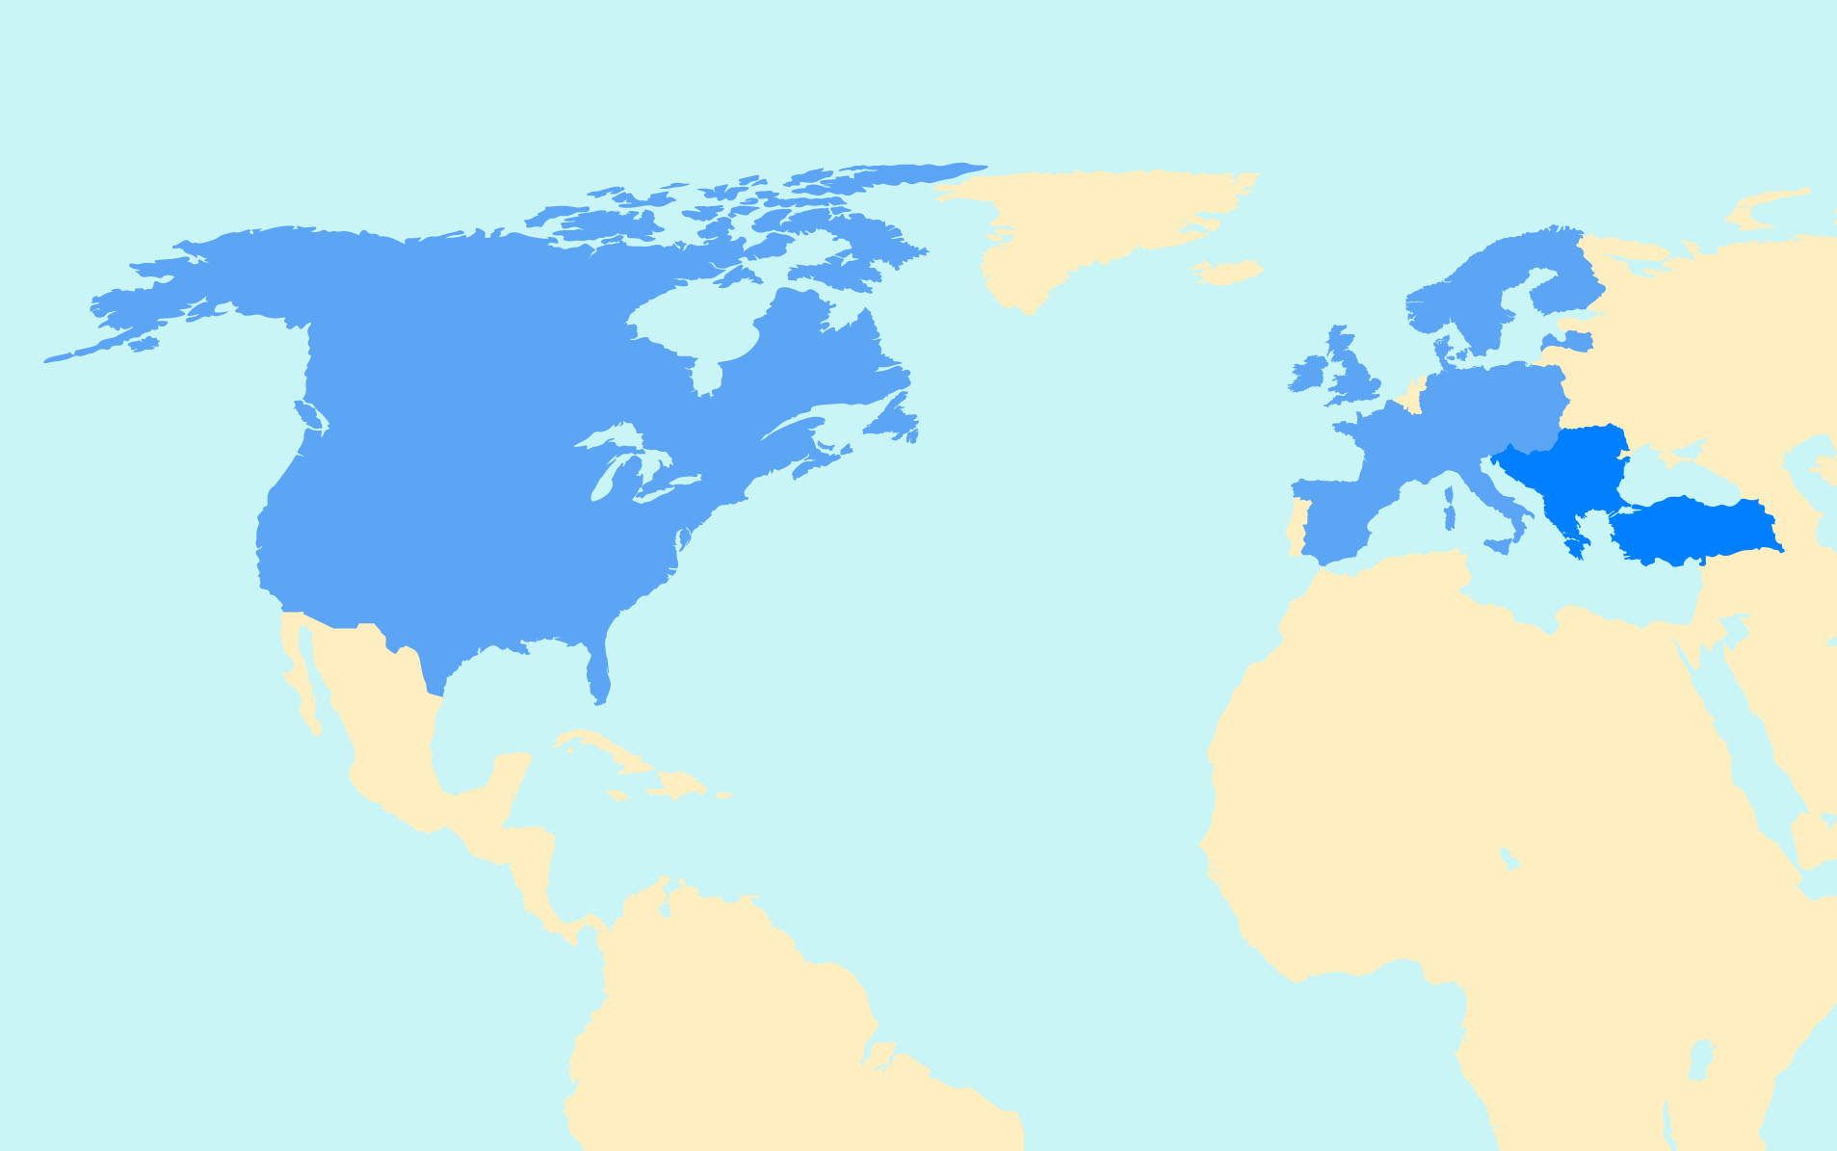
Role of the Regional Cooperation Council
As a new, regionally owned organisation the RCC represents the region, supports and initiates regional cooperation - 13 SEE beneficiaries
The RCC operates under the political umbrella of the South East Europe Cooperation Process (SEECP). Its objectives, working methods and priority areas for action are defined by the Statute and other documents adopted at Annual Meetings and endorsed by SEECP Summits.
As the main focal point for regional cooperation, the RCC:
has a key role in supporting economic and social development and related reforms;
promotes the region’s European and Euro-Atlantic integration of which regional cooperation is an essential part;
links the region with donor community in areas with a regional dimension

Slide 3

Main achievements of the RCC Secretariat in 2011 – RCC Strategy and Work Programme 2011-2013
Assist SEECP
contribution to different activities in the SEECP framework, in particular in preparing a number of sectorial meetings organized or to be organized by the SEECP C-i-Os and related to the RCC Strategy and Work Programme 2011-2013.
consultations held with the high-level representatives of the SEECP

Slide 4
Monitored and streamlined regional activities
targeted informing
periodical stock taking (RCC Annual Reports, Survey of RI&TFs, March 2011)
jointly planed and performed different activities
managing, monitoring and/or steering role in different bodies or projects of other regional initiatives (CEFTA, eSEE, CeGD, SEETO, RENA, REC, ICAM/RBM, PPII/ADP, UNECE CSE, ISRBC, NALAS, RAI, SELEC, SEEPAG, MARRI, SEPCA, SEDM, SEEC – Forum for Western Balkans Defense Cooperation, US-Adriatic Charter (A5), SEESAC, DPPI, GTF, SEECEL, RESPA, ERI SEE, RCC TF CS, RCC TF BHC, CPF, RSPC etc.)
regular bilateral meetings and consultations with a number of well-established RI&TFs, or emerging partners of the RCC SEE Public Private Partnership Network, Regional Network of Investment Promotion Agencies etc.)

Slide 5
Exert strategic leadership in regional cooperation
development of regional platforms and/or strategies in all priority areas such as: SEEIC Work Programme, Social Agenda for the Western Balkans 2020, Regional Strategic Document and the Action Plan 2011-2013 in Justice and Home Affairs, SEE Military Intelligence Chiefs Forum (SEEMIC), and Forum of the Heads of SEE National Security Authorities (SEENSA), Regional Strategy for Research and Development for Innovation for the Western Balkans etc.
support in elaborating the proposal on the need to launch regional energy strategy and its forthcoming completion, and others

Slide 6
Provide a regional perspective in donor assistance
improved communication on regional cooperation activities in the triangle RCC Secretariat and other regional initiatives, NIPAC offices and DG Enlargement
assisted/co-chaired the MB IPA Strategy Working Groups, Western Balkans Investment Framework Steering Committee Meetings, as well as International Financial Institutions (IFI) Advisory Group meetings
established or intensified contacts with other DGs in the EC (DG REGIO, DG MOVE, DG International Cooperation, DG Humanitarian Aid and Crisis Response, DG Research, Innovation and Science, DG Education and Culture, etc), as well as with the specialised units within the External Action Service, for the security cooperation area
consultations were also held with other donors interested in regional projects (ADA, SIDA, FES, HBS, GIZ, UNDP, USAID, OSCE, World Bank, SDC, BTD etc.)

Slide 7
Support increased involvement of civil society in regional activities
helping to launch (European Association of Public Service Media in South East Europe, Network of National Councils of the European Movement in SEE, ECO Social Entrepreneurs Network in SEE) and consolidate cooperation with CSO networks
permanent dialogue and/or common activities were in place with different CSO stakeholders from the region such as TACSO team, ICDT, BFPE, ICPE, ECPD, IENE, BCSDN etc.
cooperation with think tanks from the region and beyond (LSE Network of SEE researchers, universities and research institutes).

Slide 8
MAIN ACHIEVEMENTS OF THE RCC SECRETARIAT IN 2011 – per Priority Areas
ECONOMIC AND SOCIAL DEVELOPMENT
Transfer of the South East Europe Investment Committee from the OECD to the RCC Secretariat and start of the operational activities in April 2012.
Launching a structured dialogue on the Western Balkans Social Agenda 2020 with the aim of developing a regional response to the Europe 2020 Strategy.
Launching the project “Women Entrepreneurship – a job creation engine for SEE” for which the RCC Secretariat was awarded a three year contract with Swedish International Development Agency (SIDA).

Slide 9
2. ENERGY AND INFRASTRUCTURE
In the framework of the Sustainable Energy Development Regional Initiative (SEDRI), jointly launched by the Central European Initiative and RCC Secretariat, the SEDRI Task Force was established and the initial project inventory was prepared.
Participated in the preparation of final draft project proposal Expanding air transport links within the region of SEE
Initiative for regional strategic action regarding railway transport and infrastructure development
Support to the establishment of Road Safety Training Centre
Initiated mapping of the activities in the area of Climate Change Adaption in the SEE.

Slide 10
3. JUSTICE AND HOME AFFIRS
2011 – 2013 Regional Strategic Document (RSD) and the Action Plan for its implementation in the area of Justice and Home Affairs endorsed by the SEECP Ministers of Justice and Home Affairs.
Coordinated the Steering Group for the implementation of the Regional Strategic Document which designed the Monitoring and Evaluation Mechanism (M&EM) to measure the progress and the results of the regional cooperation in justice and home affairs to be functional as of January 2012.
Established, in cooperation with the Regional Anti-Corruption Initiative, the Integrity Experts Network-IEN as a SEE inter-governmental structure of the national agencies specialized in public officials’ assets declaration and incompatibilities regime.
Established, in cooperation with SEECP Chairmanship-in-Office and MARRI, the Forum of the Heads of Consular Departments from SEECP Countries.

Slide 11
4. SECURITY COOPERATION
Initiated, with full support of the EU Military Intelligence Directorate, a regional cooperation mechanism among the Chiefs of Military Intelligence - SEEMIC (three meetings already held).
Initiated regional cooperation of the Heads of the South East European National Security Authorities-SEENSA (the first meeting has been held in Sofia).
Initiated regional cooperation of the South East European Counter-Intelligence Chiefs Forum -SEECIC (preparation for holding the first meeting have been finalised and a draft concept agreed upon).

Slide 12
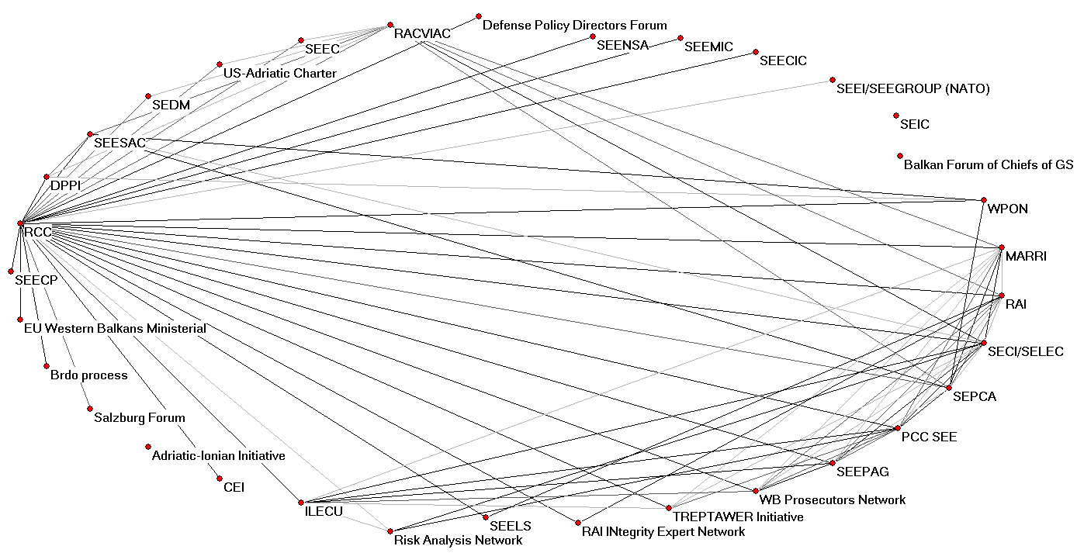
Security and JHA network – RCC perception among initiatives, in 2012
Iztok Prezelj, Faculty of Social Sciences, Ljubljana

Slide 13
5. BUILDING HUMAN CAPITAL AND PARLIAMENTARY COOPERATION
The project Building Capacity for Structural Reform in Higher Education of Western Balkan Countries (STREW) has been developed under the auspices of the RCC Secretariat, by the experts from the region and financed by TEMPUS, starting at the end of 2011.
The project on the Regional Strategy for Research and Development for Innovation for the Western Balkans (RSRDI) has been developed under the auspices of the RCC Secretariat, by the experts from the region and EC. The project will be financed from MB IPA and its implementation is expected to start in November 2011.
Establishment of the RCC Task Force on Culture and Society (in the framework of the transition of the Ljubljana Process to RCC), opening of RCC TF Secretariat in Cetinje, Montenegro, appointment of the TFCS Chair and Co-Chair and adoption of its Action Plan.
Active involvement in development and formulation of the project on the Parliamentary Cooperation in the Western Balkans and Turkey - Support to the Cetinje Parliamentary Forum. The project is expected to start in the second part of 2012 and will be financed from MB IPA.

Slide 14
6. MEDIA DEVELOPMENT ACTIVITIES
Initiated the establishment of the European Association of Public Service Media in SEE (EAPSSEE)
Facilitated the signing of the Protocol on Regional Cooperation in Education and Training among 12 members of the EAPSSEE.

Slide 15
Europe 2020: Relevance for Enlargement Policy
Europe 2020 offers the enlargement countries an anchor for reforms.
The countries are invited to adapt and adopt relevant headline targets
Enlargement countries should participate actively in the European Union programmes.
The countries are invited to organise their work on the Europe 2020 related issues in regional groups.

Slide 16
Priority 1: Smart Growth
EU 2020 FLAGSHIP INITIATIVE (“Areas most in need of attention”) | CORRESPONDING REGIONAL PLATFORM (“Setting the Strategy and Mapping Convergence”) | REGIONAL INITIATIVES/GOVERNANCE MECHANISMS/TOOLS FOR IMPLEMENTATION (“Monitoring and Supporting implementation”)
Priority 1: Smart growth
1. Digital agenda for Europe | eSEE Agenda+ | eSEE/bSEE Working Group, CeGD SEE ICT Forum Community Programmes (e.g. CIP, FP7) Pre-Accession Assistance (IPA, TAIEX)
2. Innovation Union | Regional R&D Strategy for Innovation | Steering Platform on WBC-INCO.NET SEE-ERA.Net, ERA-Net+ Community Programmes (e.g. CIP, FP7)
3. Youth on the Move | Higher Education Reform in the Western Balkans | ERISEE TFBHC Community Programmes (Youth in Action, ERASMUS Mundus) Pre-Accession Assistance (IPA, TAIEX)

Slide 17
Priority 2: Sustainable Growth
EU 2020 FLAGSHIP INITIATIVE (“Areas most in need of attention”) | CORRESPONDING REGIONAL PLATFORM (“Setting the Strategy and Mapping Convergence”) | REGIONAL INITIATIVES/GOVERNANCE MECHANISMS/TOOLS FOR IMPLEMENTATION (“Monitoring and Supporting implementation”)
Priority 2: Sustainable growth
Resource Efficient Europe | Integrated infrastructure development Sustainable Energy Development Regional Initiative | ECT RENA SEETO/Transport Community SEE PPP Network Community Programmes (LIFE+ Financial Instrument for the Environment, FP7) Pre-Accession Assistance (IPA, TAIEX)
2. An Industrial Policy for the Globalization Era | SEE Investment Committee | SEE Investment Committee CEFTA ABC BAC OECD Pre-Accession Assistance (IPA, TAIEX)

Slide 18
Priority 3: Inclusive Growth
EU 2020 FLAGSHIP INITIATIVE (“Areas most in need of attention”) | CORRESPONDING REGIONAL PLATFORM (“Setting the Strategy and Mapping Convergence”) | REGIONAL INITIATIVES/GOVERNANCE MECHANISMS/TOOLS FOR IMPLEMENTATION (“Monitoring and Supporting implementation”)
Priority 3: Inclusive growth
An Agenda for New Skills and Jobs | Social Agenda for the Western Balkans 2020 | WB Social Agenda 2020 working groups SEECEL SEE Employment Network GTF ETF Community Programmes (Integrated Action Programme in Lifelong Learning) Higher Education Reform (Tempus) Pre-Accession Assistance (IPA, TAIEX)
2. European Platform Against Poverty | Social Agenda for the Western Balkans 2020 | WB Social Agenda Working Groups SEE Health Network Community Programmes (PROGRESS) Pre-Accession Assistance (IPA, TAIEX)

Slide 19
Priority 4: Governance for Growth
EU 2020 FLAGSHIP INITIATIVE (“Areas most in need of attention”) | CORRESPONDING REGIONAL PLATFORM (“Setting the Strategy and Mapping Convergence”) | REGIONAL INITIATIVES/GOVERNANCE MECHANISMS/TOOLS FOR IMPLEMENTATION (“Monitoring and Supporting implementation”)
Priority 4: Governance for growth
Good Governance Agenda | Regional Strategic Document for Justice and Home Affairs | RESPA CeGD NALAS RAI SECI/SELEC SEEPAG PCC-SEE Secretariat SEDM Others

Slide 20
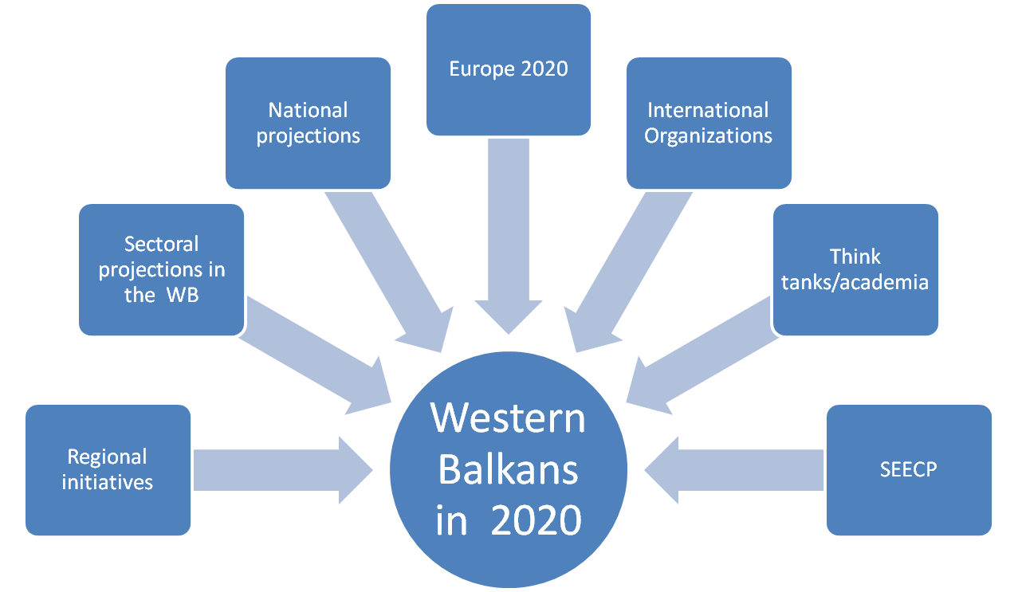
Western Balkans in 2020
Result of a Broad Consultative Process

Slide 21
Annex I
Taskforces and Initiatives in SEE
 | Country Regional Initiative | Albania | Bosnia and Herzegovina | Bulgaria | Croatia | Greece | Republic of Moldova | Montenegro | Romania | Serbia | The Former Yugoslav Republic of Macedonia | Turkey | UNMIK/ Kosovo | Slovenia and Others
Economic and Social Development | SEE Investment Committee (SEEIC) - Paris | x | x | x | x |  | x | x | x | x | x
 | Central European Free Trade Agreement (CEFTA) - Brussels | x | x |  | x |  | x | x |  | x | x |  | x
 | Business Advisory Council (BAC) - Thessaloniki | x | x | x | x | x | x | x | x | x | x | x | x
 | Regional Network of National Investment Promotion Agencies in SEE (RNIPA) - Rotating | x | x |  | x |  |  | x |  | x | x
 | Regional Rural Development Standing Working Group (SWG) - Skopje | x | x | x | x |  |  | x | x | x | x |  | x
 | SEE Employment and Social Policy Network (SEESPN) - No headquarters | x | x | x | x |  | x | x | x | x | x |  | x
 | Centre for Public Employment Services of SEE Countries (CPESSC) - Rotating |  | x | x | x |  |  | x | x | x | x | x |  | Slovenia
 | SEE Trade Union Forum (SEETUF) - Zagreb/Sarajevo | x | x | x | x |  |  | x | x | x | x |  | x
 | Adriatic Region Employers' Centre (AREC) - Zagreb | x | x |  | x |  |  | x |  | x | x
 | SEE Health Network Skopje | x | x | x | x |  | x | x | x | x | x
 | Centre for eGovernance Development (CeGD) - Ljubljana |  |  |  |  |  |  |  |  |  |  |  |  | RCC/PPP
 | eSEE Initiative and bSEE Task Force - UNDP Sarajevo | x | x |  | x |  | x | x | x | x | x |  | x

Slide 22
Annex I
Taskforces and Initiatives in SEE
 | Country Regional Initiative | Albania | Bosnia and Herzegovina | Bulgaria | Croatia | Greece | Republic of Moldova | Montene- gro | Roma- nia | Serbia | The Former Yugoslav Republic of Macedonia | Turkey | UNMIK/ Kosovo | Slove=nia and Others
Energy and Infrastructure | Energy Community Secretariat (ECS) -Vienna | x | x |  | x |  | x | x |  | x | x |  | x
 | South East Europe Transport Observatory (SEETO), expected future Transport Community - Belgrade | x | x |  | X |  |  | x |  | x | x |  | x
 | ISIS Programme Secretariat -Brussels | x | x | x | x |  |  | x | x | x | x |  | x | EC, RCC
 | International Sava River Basin Commission (ISRBC) - Zagreb |  | x |  | x |  |  |  |  | x |  |  |  | Slovenia
 | Regional Environmental Centre for Central and Eastern Europe (REC) - Szentendre, Hungary | x | x | x | x |  |  | x | x | x | x | x |  | 19 more European countries and USA
 | Regional Environmental Network for Accession - Vienna | x | x |  | x |  |  | x |  | x | x | x | x
 | Network of Associations of Local Authorities of SEE (NALAS) - Skopje | x | x | x | x |  | x | x | x | x | x | x | x | Slove-nia

Slide 23
Taskforces and Initiatives in SEE
Annex I
 | Country Regional Initiative | Albania | Bosnia and Herzegovina | Bulgaria | Croatia | Greece | Republic of Moldova | Montene- gro | Romania | Serbia | The Former Yugoslav Republic of Macedonia | Turkey | UNMIK/ Kosovo | Slove- nia and Others
Justice and Home Affairs | Migration, Asylum and Refugee Regional Initiative (MARRI) - Skopje | x | x |  | x |  |  | x |  | x | x
 | Regional Anticorruption Initiative (RAI) - Sarajevo | x | x | x | x |  | x | x | x | x | x |  | Observer
 | Southeast European Cooperative Initiative – Regional Centre for Combating Transborder Crime (SECI Centre) , future Southeast European Law Enforcement Centre (SELEC) - Bucharest | x | x | x | x | x | x | x | x | x | x | X | Observer | Hungary, Slovenia
 | Southeast European Prosecutors Advisory Group (SEEPAG) - Bucharest | x | x | x | x | x | x | x | x | x | x | X |  | Slovenia
 | Southeast Europe Police Chiefs Association (SEPCA) - Sofia | x | x | x | x |  | x | x | x | x | x
 | Women Police Officer Network (WPON) - No headquarters | x | x | x | x |  | x | x | x | x | x
 | Secretariat of Police Cooperation Convention for Southeast Europe (PCC- SEE Secretariat) - Ljubljana | x | x | x |  |  | x | x | x | x | x
 | Western Balkans Prosecutor Network (PROSECO) - No headquarters | x | x |  | x |  |  | x |  | x | x

Slide 24
Annex I
Taskforces and Initiatives in SEE
 | Country Regional Initiative | Albania | Bosnia and Herzegovina | Bulgaria | Croatia | Greece | Republic of Moldova | Montene- gro | Romania | Serbia | The Former Yugoslav Republic of Macedonia | Turkey | UNMIK/ Kosovo | Others
Security Cooperation | Centre for Security Cooperation (RACVIAC) Zagreb | x | x |  | x | x |  | x |  | x | x | x
 | Disaster Preparedness and Prevention Initiative (DPPI SEE) - Sarajevo | x | x | x | x |  | x | x | x | x | x | x |  | Slovenia
 | South Eastern and Eastern Europe Clearinghouse for the Control of Small Arms and Light Weapons (SEESAC) - Belgrade |  |  |  |  |  |  |  |  |  |  |  |  | RCC, UNDP
 | South East Europe Defense Ministerial (SEDM) - Rotating | x | x | x | x | x | Observer | x | x | x | x | x |  | Italy, Ukraine, Slovenia,USA
 | The United States- Adriatic Charter - No headquarters | x | x |  | x |  |  | x |  |  | x |  |  | USA
 | South Eastern Europe Clearinghouse (SEEC) - No headquarters | x | x |  | x |  |  | x |  | x | x |  |  | Slovenia

Slide 25

Annex I
Taskforces and Initiatives in SEE
 | Country Regional Initiative | Albania | Bosnia and Herzegovina | Bulgaria | Croatia | Greece | Republic of Moldova | Montenegro | Romania | Serbia | The Former Yugoslav Republic of Macedonia | Turkey | UNMIK/ Kosovo | Slovenia and Others
Building Human Capital and Cross-cutting Issues | RCC Task Force Fostering and Building Human Capital (TF BHC) -Vienna | x | x | x | x | x | x | x | x | x | x | x | x | All members of RCC Board
 | RCC Gender Task Force (GTF) - Zagreb | x | x | x | x | x | x | x | x | x | x |  | x | Slovenia
 | Education Reform Initiative of South Eastern Europe (ERI SEE) -Belgrade | x | x | x | x |  | x | x | x | x | x |  | x | TFFBHC
 | Regional School of Public Administration (RESPA) -Danilovgrad | x | x |  | x |  |  | x |  | x | x |  | x
 | South East European Centre for Entrepreneurial Learning (SEECEL) -Zagreb | x | x |  | x |  |  | x |  | x | x | x | x

Slide 26
Annex I
Taskforces and Initiatives in SEE
 | Country Regional Initiative | Albania | Bosnia and Herzego- vina | Bulgaria | Croatia | Greece | Republic of Moldova | Montene- gro | Romania | Serbia | The Former Yugoslav Republic of Macedonia | Turkey | UNMIK/ Kosovo | Sloveniaand Others
Parliamentary Cooperation | Regional Secretariat for Parliamentary Cooperation in South Eastern Europe (RSPC SEE) - Sofia | x | x | x | x | x | x | x | x | x | x | x
 | Conference of the European Integration Parliamentary Committees of States participating to the Stabilization and Association Process (COSAP) - Rotating | x | x |  | x |  |  | x |  | x | x
 | CETINJE Parliamentary Forum - Cetinje | x | x | x | x |  |  | x | x | x | x
Regional Cooperation Council |  | x | x | x | x | x | x | x | x | x | x | x | x | x
Total: 42 |  | 38 | 40 | 24 | 39 | 9 | 20 | 39 | 25 | 39 | 39 | 13 | 17 | Sloven. 12
Headquarters South East Europe: 26+ 4 rotating | Per country: | 0 | 4 | 2 | 6 | 1 | 0 | 2 | 2 | 3 | 4 | 0 | 0 | 2Slov. 7 others

Slide 27
Table 1. SEE Regional Cooperation Events per Area
Cooperation Area | Organized/ co-organised by RCC | Others | Total
Economic and Social Development | 12 | 51 | 63
Energy and Infrastructure | 9 | 36 | 45
Justice and Home Affairs | 9 | 39 | 48
Security Cooperation | 5 | 32 | 37
Building Human Capital | 5 | 21 | 26
Parliamentary Cooperation | 2 | 7 | 9
Media Cooperation | 4 | 10 | 14
Cooperation of Local Communities | 1 | 1 | 2
Civil Society Cooperation | 1 | 8 | 9
Events of political profile | 0 | 31 | 31
Horizontal Cooperation | 2 | 8 | 10
RCC PR | 3 | 0 | 3
Managing of the RCC | 5 | 0 | 5
Total | 58 | 244 | 302

Slide 28
Table 2. SEE Regional Cooperation Meetings/per country
SEE
Country | Town |  |  |  |  | Total
Albania | Tirana 7 | Duress 2 |  |  |  | 9
Bosnia and Herzegovina | Sarajevo 64 | Banja Luka 4 | Mostar 1 |  |  | 69
Bulgaria | Sofia 7 | Burgas 1 | Pravec 1 |  |  | 9
Croatia | Zagreb 19 | Dubrovnik 3 Cavtat 1 | Split 2 Zadar 1 | Pula 1 Rovinj 1 | Opatija 1 | 29
Greece |  | Thessaloniki 2 |  |  |  | 2
Moldova | Chisinau 1 |  |  |  |  | 1
Montenegro | Podgorica 3 | Cetinje 2 | Budva 17 | Danilovgrad 2 | Milocer 1 | 25
Romania | Bucharest 4 |  |  |  |  | 4
Serbia | Belgrade 32 | Novi Sad 1 | Palic 1 | Kopaonik 3 | Viminacium 1 Arandjelovac 1 | 39
Slovenia | Ljubljana 7 | Bled 4 | Brdo kod Kranja 1 | Maribor 1 |  | 13
The Former Yugoslav Republic of Macedonia | Skopje 8 | Ohrid 5 |  |  |  | 13
Turkey | Ankara 1 | Istanbul 4 | Antalya 1 |  |  | 6
Kosovo* | Pristina 5 | Peja 1 |  |  |  | 6
Subtotal |  |  |  |  |  | 225
*This designation is without prejudice to positions on status, and is in line with UNSC 1244 and the ICJ Opinion on the Kosovo declaration of independence.

Slide 29
Table 2. SEE Regional Cooperation Meetings/per country
Others
Austria | Vienna |  |  |  |  | 13
Belgium | Brussels 28 | Antwerp 1 | Brugges 1 |  |  | 30
Cyprus | Limasol |  |  |  |  | 1
Czech Republic | Prague |  |  |  |  | 1
Estonia | Tallin |  |  |  |  | 1
France | Paris 4 | Strasbourg 1 |  |  |  | 5
Germany | Berlin 4 | Regensbourg 1 | Ingolstadt 1 | Garmish 1 |  | 7
Hungary | Budapest |  |  |  |  | 5
Italy | Rome 1 |  | Turin 2 | Trieste 3 |  | 6
Luxembourg | Luxembourg |  |  |  |  | 2
Norway |  |  |  | Hamar |  | 1
Sweden | Stockholm |  |  |  |  | 1
Switzerland |  | Geneva 1 | Zurich 1 |  |  | 2
United States |  | New York 1 |  | Baltimor 1 |  | 2
Subtotal |  |  |  |  |  | 77
Total | 302

