Slide 1

INTERNATIONAL CONFERENCE ON HIGHER EDUCATION
PETROVAC
MONTENEGRO
MAY 24, 2012
SLOVENIAN HIGHER EDUCATION 2012
Andrej Kotnik

Slide 2
students
 | undergraduate | postgraduate | TOTAL
1991/92 | 36.504 | 1.647 | 38.151
2005/06 | 73.967 | 8.344 | 82.311
2009/10 | 98.973 | 15.900 | 114.873

Slide 3




higher education institutions
University of Ljubljana, 1919 (41.000 students)
University of Maribor, 1975 (16.000 students)
University of Primorska, 2003 (5.000 students)
University of Nova Gorica, 2006 (500 students)
30 private HEI – (9.000 students)
EMUNI

Slide 4
PRIVATE PUBLIC institutions
HE is defined as a public services, regrardless of their source of funding
In addition to public HEi, private institutions also operate in the HE area.
Private HEI independently determine their own mission
Private HEi are regulated within the same legal framework as the operation of public Hei (concession )
96,5% Vs. 3,5%
New Master Programe (criterias):
  Only when study programme in private HEi is not implemented at public HEi and at the same time there is a need for a certain study programme and the study programme is of high quality.

Slide 5

higher education act 1993 -2011…….
1993
1999 (EU citizens, student representative,..)
2004-05 (Bologna, ECTS,DS, JSP,QA,..)
2009 (transnational, SQAA, external accreditation,..)
2011 (E-HE,..
2012… – new legislation in preparation
Other regulations

Slide 6

National Masterplan for Higher Education 2011-2020
Knowledge is a public good and HE is a public responsibility

Slide 7

Goals of National Masterplan 2011-2020
Quality (internationally comparable education, employability, mobility)
Social dimension (access and completion of the study, lifelong learning)
Diversification (variety of types and missions of institutions and programs )
“Knowledge triangle” (cooperation)
Internationalisation (mobility)

Slide 8

Key pillars of National Masterplan 2011-2020
Higher Education System
Study structure and higher education qualifications
Financing
Diversification
Quality and accountability
Social dimension
Internationalisation
47 MEASURES

Slide 9
SOME MEASURES
M 1: The redefinition of conditions for the establishment and
operation of individual types of higher education institutions.
M3: The establishment of a system of internal organisation of universities and higher education institutions capable of promoting cooperation between departments and/or different institutions among themselves
M 4: The enhancement of co-operation between higher education institutions and public research institutes (personel, public reso., wage system
M 5: The enhancement of cooperation between higher education institutions with economic and public sectors. (cooperation, consulting fro drafting programme, non-academic perosnel
M 12: Modification of entrance conditions and enrolment posts

Slide 10
SOME MEASURES
M 13: The establishment of the funding system of higher education institutions so that development will be encouraged and elements of quality and cooperation with the environment will be taken into consideration. (from input to output, basic, developement pillar)
M 17: Formulation of missions of higher education institutions and profiling of institutions
M 22: The transition from programme to institutional accreditation
M 30: The establishment of co-operation with the region of the Western Balkans as an example of good practice in the field of regional mobility by 2020
M 39: Funding studies in the first and second cycle at any time in life under certain conditions

Slide 11
governance structure of he
Council for Higher Education
č
Ministry of Education, Science, Culture and Sport
Ministry of Labour, Family and Social Affairs
SQAA
Slovene Human Resources Development and Schoolarship Fund
CMEPIUS
SRA
Universities and higher education institutions

Slide 12

Internal integration , management….
same tradition in the region
individual accounts of faculties
lump sum money distribution
(too) many study programmes
rector = director
no scheme for training

Slide 13
Fragmantation of study programmes !
 | Faculties | 1. cycle |  |  |  | 2. cycle |  | 3. cycle
 |  | University study programmes | Students | Proffesional study programmes | Students | Study programmes | Students | Study programmes | Students
University of Ljubljana | 26 | 125 | 26.088 | 31 | 7.912 | 175 | 4.493 | 22 | 2.607
University of Maribor | 16 | 56 | 7.508 | 27 | 5.685 | 74 | 2.349 | 34 | 718
University of Primorska | 6 | 23 | 1.470 | 8 | 2.563 | 29 | 990 | 12 | 197
University of Nova Gorica | 6 | 8 | 112 | 3 | 131 | 12 | 62 | 9 | 134
FIŠ | 1 | 1 | 32 | 1 | 122 | 1 | 38 | 1
EUMUNI | 1 |  |  |  |  | 2 |  | 1
Private Hei | 33 | 9 | 826 | 44 | 6.368 | 39 | 1.488 | 15 | 409
TOTAL | 89 | 222 | 36.036 | 114 | 22.781 | 332 | 9.420 | 94 | 4.065
762 Study
UL 353 study programmes (only 20 interdisciplinary prg. as intra-university coop)

Slide 14

Analytical information system for higher education e-HE
  11 different information systems in universities and HEI
  8 separate HEI without appropriate information solutions
  the need for a unified governmental register of higher education
Complex information and analytical system for all participants:
  On line evidence of HEI, programmes and courses
  Central Calls for student enrolment
  Evidence of professors, students and graduates
  Evidence of governmental student supports
  Application for student dormitories
  On line analysis and reporting
  Friendly Web portal in Slovenian and English language

Slide 15
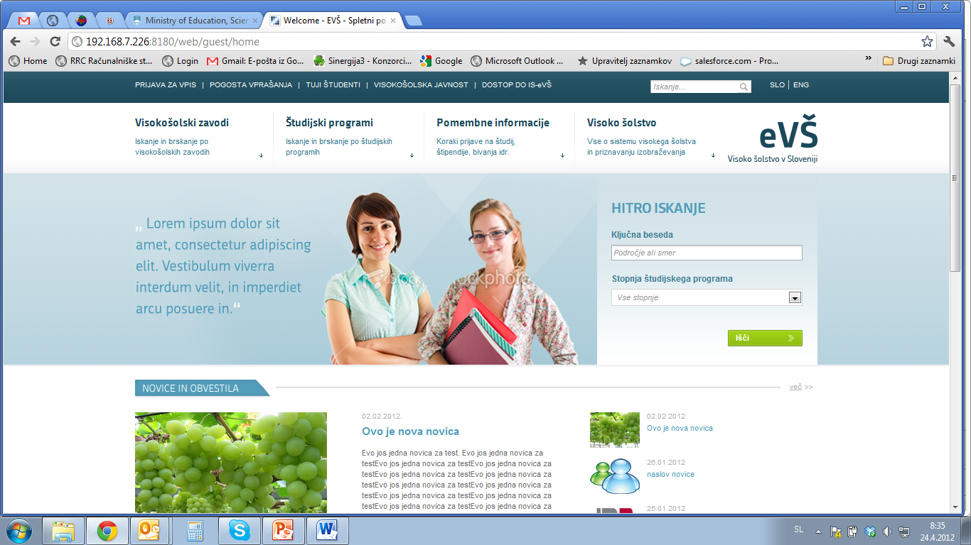
e-vš portal

Slide 16
Thank you !
Andrej Kotnik

