Slide 1

“Goce Delcev” University
“Goce Delcev” University
Recognize your future…
Current state…..

Slide 2

Facts about us
www.ugd.edu.mk
“Goce Delcev” University
The University is founded on 27th of March 2007
It integrates 13 faculties and more than 100 study programmes
The seat of the University is in Shtip
The University has teaching centers in 11 cities of the Republic of Macedonia
More than 16.000 students study at the University

Slide 3
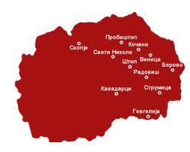
“Goce Delcev” University
Shtip is a city in the eastern part of Republic of Macedonia in the valley of the river Bregalnica.
The number of inhabitants in Shtip is 47.796 Shtip is one of the oldest cities in Macedonia, located on a surface of 81 km2.

Slide 4
The studies of “Goce Delcev” University are based on the systems 3+2+3 and 4+1+3, which means that every study programme can continue in second cycle studies with duration of 2 or 1 year respectively.
Study programmes of three cycle higher education are organized on the faculties of the University:
The first cycle studies are realized on the basis of accredited study programmes, which are designed in accordance with the credit – transfer system.
“Goce Delcev” University
first cycle university studies
second cycle university
third cycle university studies

Slide 5
CAMPUS 1
Rector’s Office
CAMPUS 2
Faculty of natural and technical sciences
CAMPUS 3
Faculty of Medical Sciences
CAMPUS 4
Faculty of Education
Faculty of Agriculture
Faculty of computer science and information technologies
Faculty of mechanical engineering
Faculty of electrical engineering
Faculty of technology
Medicine
Dentisrty
Pharmacy
Professional studies – 3 years
Faculty of Philology
Faculty of Economics
Faculty of tourism and business logistics - Gevgelija
Faculty of law - Kocani
Faculty of Music
“Goce Delcev” University

Slide 6
Institute for archeology and history
The Institute for archeology and history (INISA) has a goal to carry out scientific, research and applicable work in the field of history and archeology of Macedonia and to present the results in front of the scientific institutions and all subjects interested in the historical and archeological truth, from our country and abroad.
Institute for informatics
The Institute for informatics represents a highly-professional IT institution, in whose work participate IT experts of "Goce Delcev" University - Shtip and others. The Institute represents a leading scientific—research institution, which is the holder of the ICT area. It realizes its work through developmental, scientific – research and applicable projects.
Institute for languages
The basic role of the Institute for languages is learning and improving the foreign languages, issuing certificates for knowledge of one of the foreign languages for the needs of enrolling students in the post-graduates studies of "Goce Delcev" University.
“Goce Delcev” University

Slide 7
Interuniversity
Cooperation Center
The Interuniversity Cooperation Center fosters cooperation between Goce Delcev University and other universities from Macedonia and abroad. The ICC takes part in the preparation, signing and implementation of cooperation contracts, and preparation and implementation of exchange programs for staff and students with other universities.
University Sports Center
The University Sports Center develops and promotes the sport activities of the students and employees. There are teams of many sports within the University Sports Center. There are currently several University clubs for basketball, table-tennis, chess and mountaineering.
The University Cultural Center
The University Cultural Center organizes events, promotes different artistic activities performed through series of: art exhibitions, stage plays, film screening, music concerts, book promotions, magazines and other publications, discussions, workshops, art performances.
“Goce Delcev” University

Slide 8
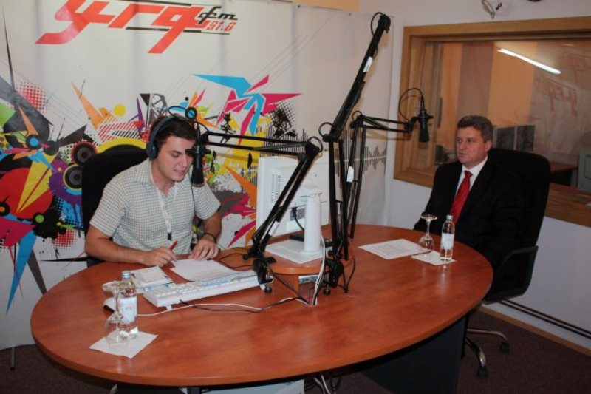
Public Relations Center
The Public Relations Center at “Goce Delcev” University in Shtip establishes communication with the wider public in this country and certain individuals in relation to the University from abroad.
“Goce Delcev” University
Within the frameworks of the University, the University radio “UGD FM” successfully operates, whose programme could be followed on the frequency of 91,0 megahertz in Shtip and the nearby area. Moreover, all users of Internet are enabled to follow the programme online, on the link from the official web – site of the “Goce Delcev” University, www.ugd.edu.mk.

Slide 9
Lifelong Learning Center
The Lifelong Learning Center (Lifelong Education) Lifelong Learning Programme has a goal to prepare, implement, coordinate and organize activities connected with learning throughout the entire course of people’s lives which aims to promote knowledge, skills and competence, as well to improve the competences, to assist in gaining new skills, qualifications and opportunities for professional development.
E-learning Center
The Electronic Learning Center is responsible for promotion and implementation of modern tools for learning at the University, new technologies (interactive whiteboards, graphic whiteboards, multimedia software and hardware, audio-visual equipment etc), as well as training for teachers and students from universities and schools in Macedonia and abroad.
Quality Assurance Center
The Quality Assurance Center collects, analyses and uses relevant information for effective management of the study programmes and other activities of the University. It strives to improve and refine the education that the University offers to its students.
“Goce Delcev” University

Slide 10
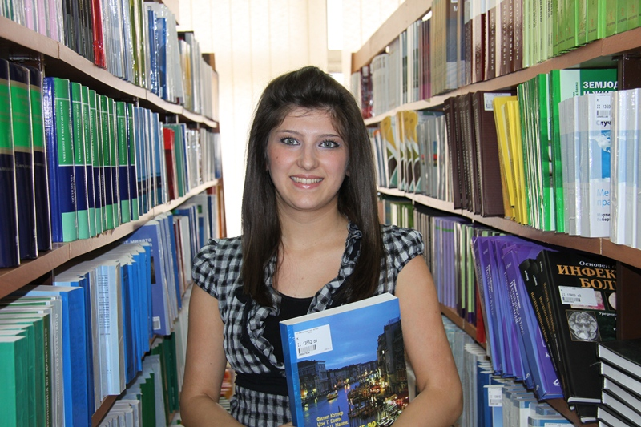
University Library
In the University library, that comprises the libraries from the four University campuses, students can find the entire professional literature, handbooks and magazines. The libraries dispose of reading – rooms with computer equipment, and the entire book – list of the University library has an electronic form that eases the students’ approach.
E-Library
“Goce Delcev” University

Slide 11
IT-Center
The mission of the IT Center is to provide fast and efficient work, i.e. communication of every one involved in the “Goce Delcev” University – Shtip.
The vision of the Center is to create one integrated University, where the technology and information will be on a highest level.
The IT Center plans, implements and maintains the University’s information system and computer network, electronic mail, log-in system for employees and students, web portal, and data protection and storing.
Offices for career and alumni club
The offices for career and alumni club are in service of the students who seek job and programmes for practice, as well as the employers who seek prospective professionally qualified staff.
The offices for career and alumni club give high-quality services related to professional orientation and development of students.
“Goce Delcev” University

Slide 12
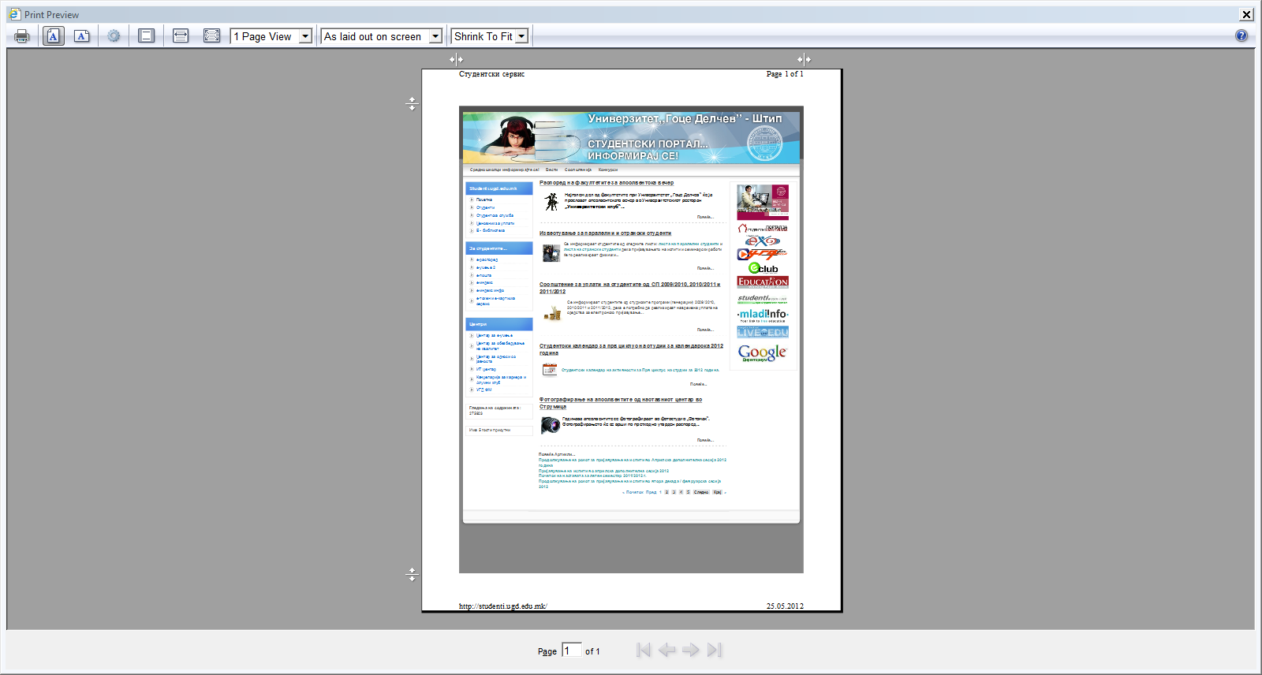
“Goce Delcev” University
http://studenti.ugd.edu.mk/

Slide 13
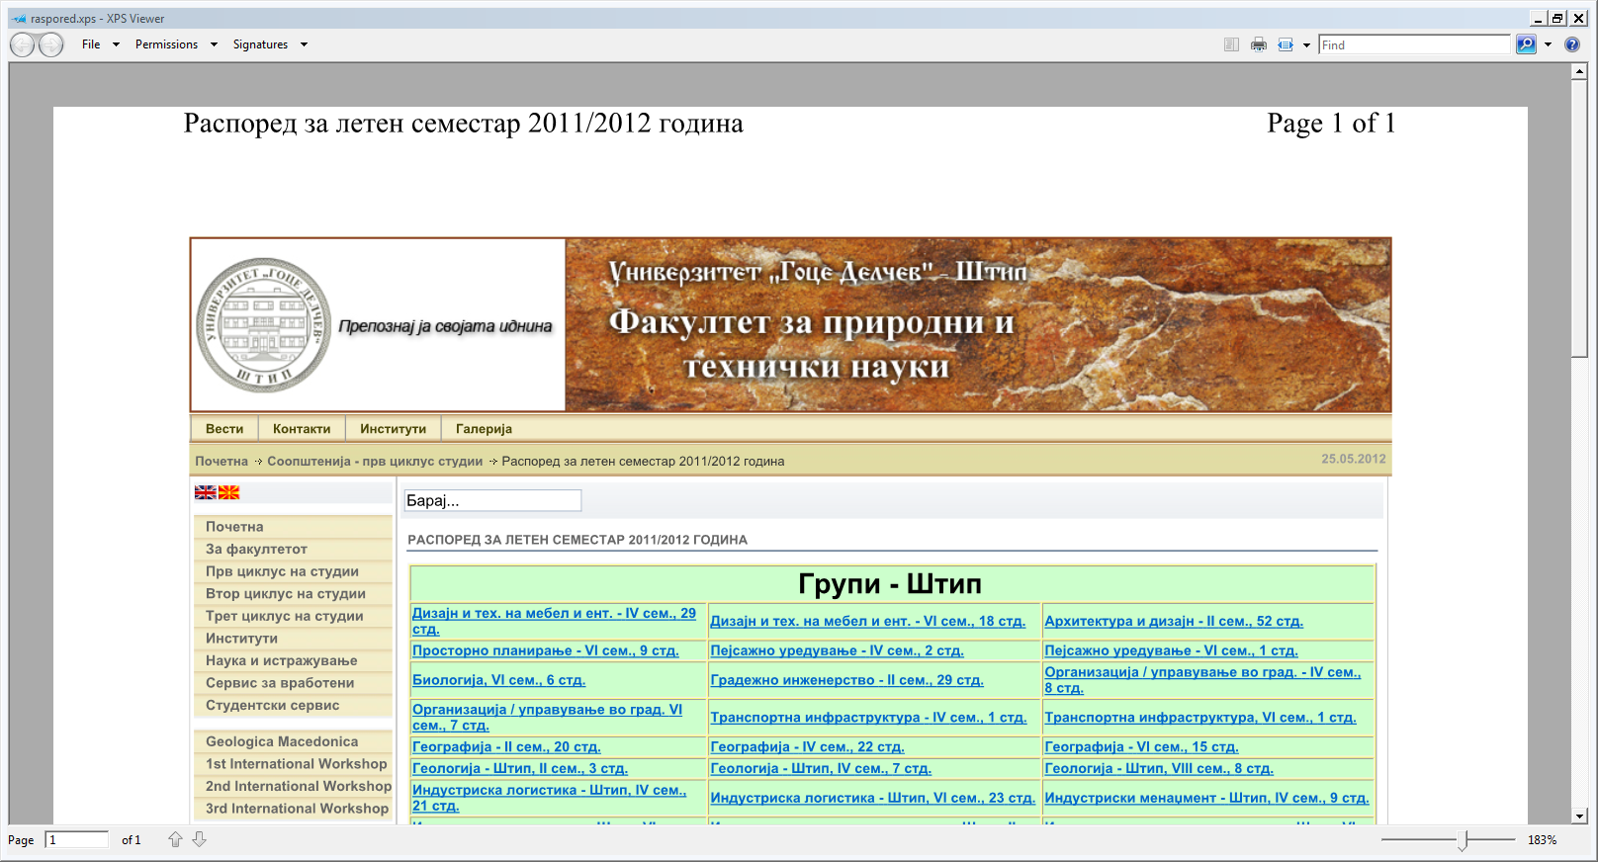
“Goce Delcev” University

Slide 14
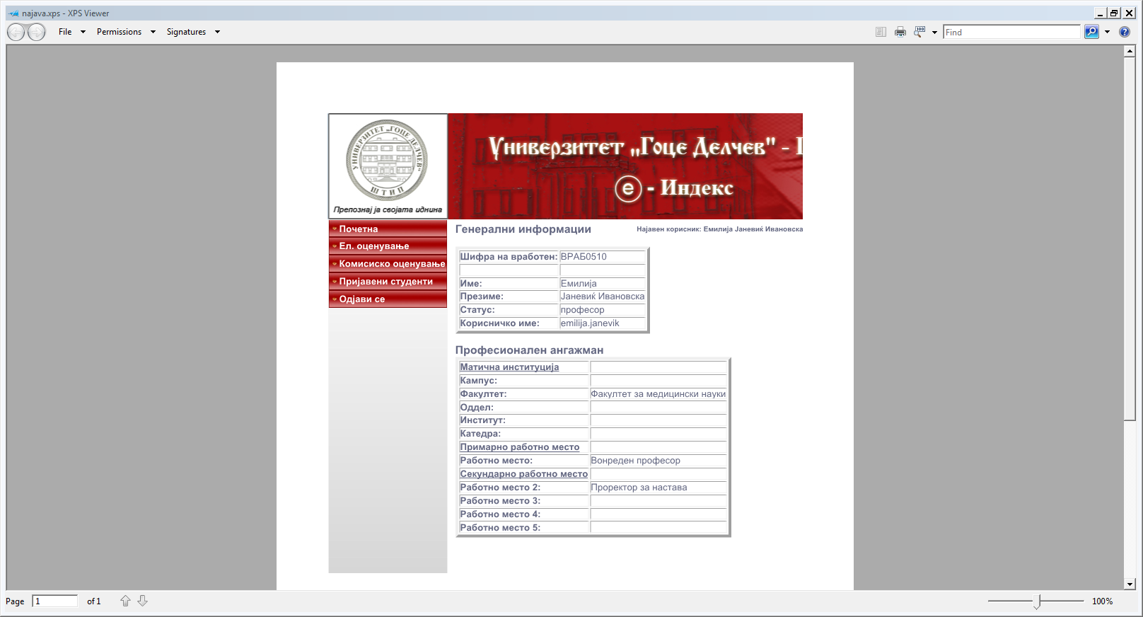
“Goce Delcev” University

Slide 15
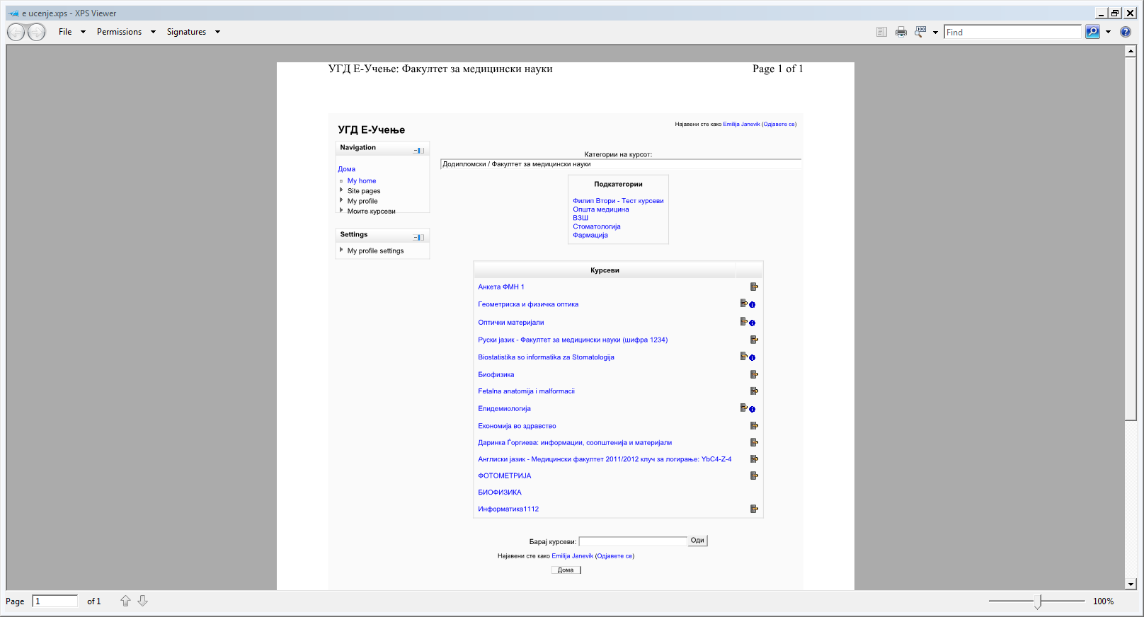
“Goce Delcev” University

Slide 16

“Goce Delcev” University
PORTAL FOR STUDENTS ACCOMMODATION
(http://smestuvanje.ugd.edu.mk/)
The students and all interested potential users have an opportunity to advertise for free on the portal for student accommodation. Through easy navigation, the users of the portal will have an opportunity to advertise or look for apartment, roommate or book, following the instruction of the portal.
The goal of the portal is to provide the students with fast, efficient and safe method of obtaining the necessary information.
By simple registration to the portal, all students that need accommodation, search book or roommate, as well as all advertisers, will have an opportunity to receive the necessary information with just one click. The portal for student accommodation smestuvanje.ugd.edu.mk is one more effort of the “Goce Delcev” University to provide the students with a quality student life.

Slide 17

VISION…….
“Goce Delcev” University

Slide 18
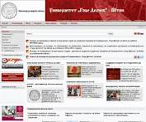
“Goce Delcev” University
Visit the virtual UGD 360 campus of the University "Goce Delchev" – Stip…
www.ugd.edu.mk
Thank you for the attention!

