Slide 1


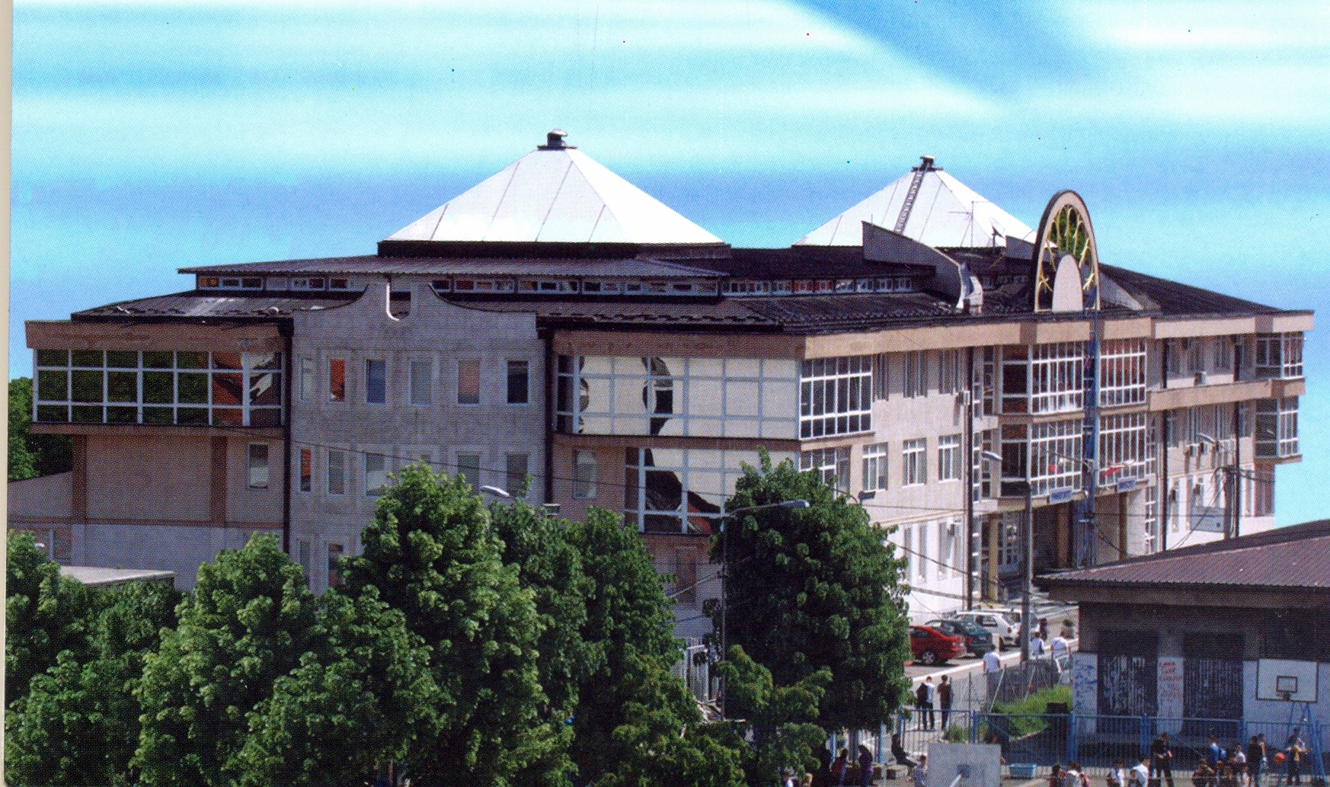
State University of Novi Pazar (SUNP)
STREW TEMPUS PROJECT-Rectors’ Working Group Meeting, May 25, 2012
Prof. dr Žarko Barbarić, zbarbaric@np.ac.rs
STATE UNIVERSITY OF NOVI PAZAR,SERBIA
VUKA KARADŽIĆA BB, 36 300 NOVI PAZAR
Web: www.np.ac.rs
Mail: rektorat@np.ac.rs, univ_np@yahoo.com
Tel:+381 20 317 752
Fax +381 20 337 669

Slide 2
Organizational Structure
COUNCIL
RECTOR
SENATE
TEACHING VICE RECTOR
SCIENCE VICE RECTOR
FINANCE VICE RECTOR
LEGAL AND ADMINISTRATION ISSUES VICE RECTOR
Student Service
Research and Science
Centre
Financial Service
Rector Office
Student Parliament
General Secretary
Information Technology Centre
Student Vice chancellor
Legal Service
International Cooperation
Technical Service
Quality Assurance Centre
IT Service
Quality Assurance Office
Career Development Office
Human Resources
Law Department
Economy Department
Philosophical
Department
Philological Department
Mathematical
Department
Technical
Department
Chemical Technology
Department
Biomedical Department
Art
Department
Multidisciplinary
Department
Law
Economy
Psychology
Serbian Language and Literature
Mathematics
Computer Engineering
Chemistry
Biology
Fine Arts
Energy Efficiency
Mathematics
and Informatics
Architecture
Agriculture Production
Rehabilitation
English
Language and Literature
Management in HE
Civil Engineering
Sport and PE
IT and Physics
Food Technology
Mathematics
and Physics
Audio and Video Technology
Biotechnology

Slide 3
Management Structure
COUNCIL
RECTOR
SENATE
TEACHING VICE RECTOR
SCIENCE VICE RECTOR
FINANCE VICE RECTOR
LEGAL AND ADMINISTRATION ISSUES VICE RECTOR
EXPERT-SCIENTIFIC COUNCILS
University council
DEPARTMENTS COUNCIL
HEAD OF DEPARTMENTS
HEAD OF STUDY PROGRAMS
Law Department
Economy Department
Philosophical
Department
Philological Department
Mathematical
Department
Technical
Department
Chemical Technology
Department
Biomedical Department
Art
Department
Multidisciplinary
Department
Law
Economy
Psychology
Serbian Language and Literature
Mathematics
Computer Engineering
Chemistry
Biology
Fine Arts
Energy Efficiency
Mathematics
and Informatics
Architecture
Agriculture Production
Rehabilitation
English
Language and Literature
Management in HE
Civil Engineering
Sport and PE
IT and Physics
Food Technology
Mathematics
and Physics
Audio and Video Technology
Biotechnology

Slide 4
Legal University Structure
University is a legal person (body)
Departments are organizational units, having no legal competence
IT Center services staff and students
Information system is being developed
Students enroll to the University

Slide 5
Initial Strategy
Rationalization
Innovation
Preservation
Rationalization was the dominant element of strategy and partially Innovation
The outcome of this strategy was a fully integrated university

Slide 6
Aiming Strategy
Rationalization
Preservation
Innovation
Rationalization, Innovation and Preservation make an interdependent system with its own feedback loops
Designing and operating the appropriate balance within this system is at the core of a successful strategic management for the University change

Slide 7
Vision
SUNP is the first fully integrated university in the Republic of Serbia, with its future vision of improving all three previously stated segments of this process
It also means higher quality in knowledge, teaching process and students’ involvement at all university levels
Full participation in the European university space according to its specific features

Slide 8
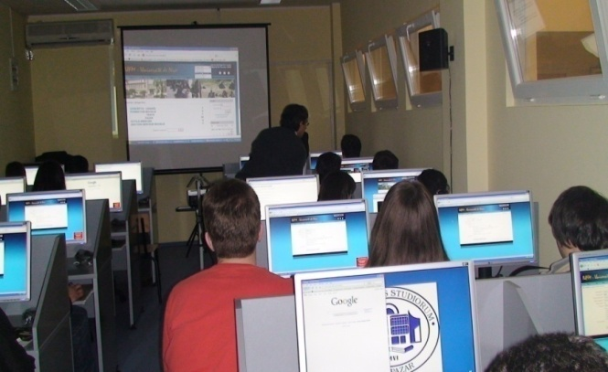
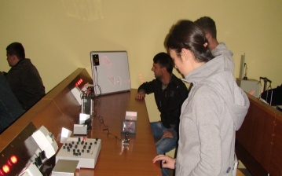
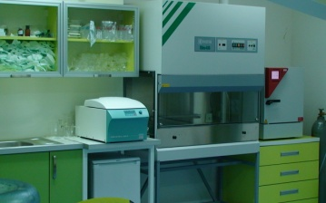
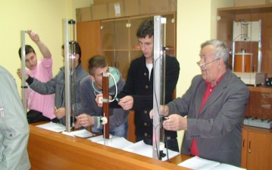
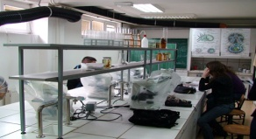
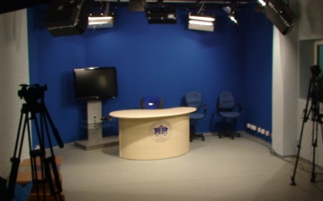
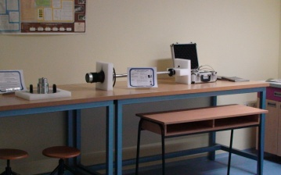
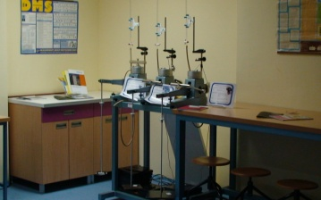
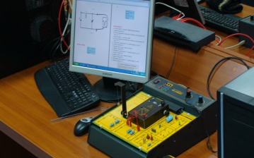
THANK YOU !

